Slide 1


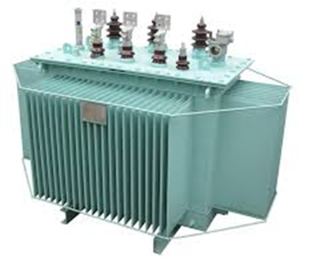
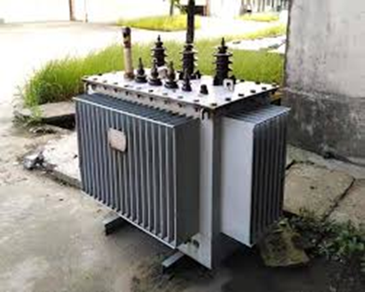
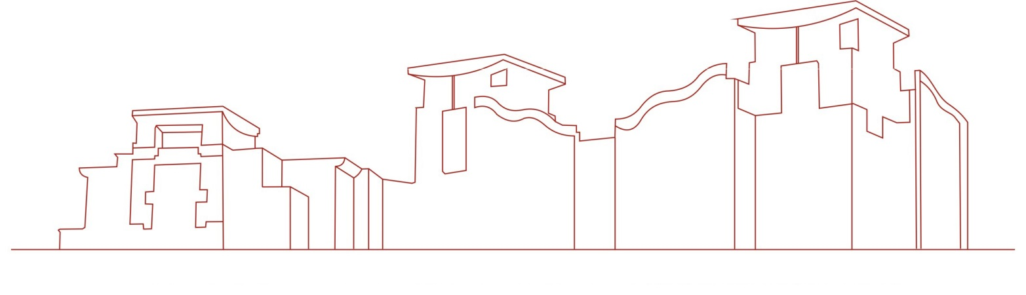
Power Transformer
This creation department provides a power transformer, which solves the problem that when the existing power transformer is in use, because the power transformer is used for a long time, high temperature will be generated inside, which will affect the aging of the internal coil, resulting in poor heat dissipation effect of the existing power transformer during use. It is convenient for users to use and improves the practicability of power transformers.

